Slide 1

UNIT II
Divide and Conquer
CO2: Solve problems using divide and conquer approach and analyze them.

Slide 2
SLO 1
Understand the key concepts of divide and conquer strategy.
Design a solution for Maximum Sub array Problem using divide and conquer strategy.

Slide 3
UNIT - II

Slide 4
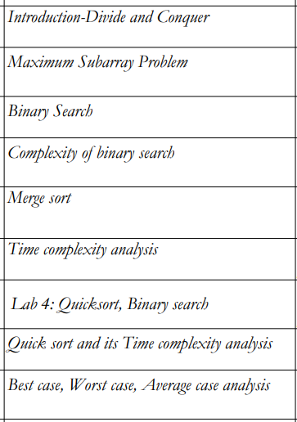
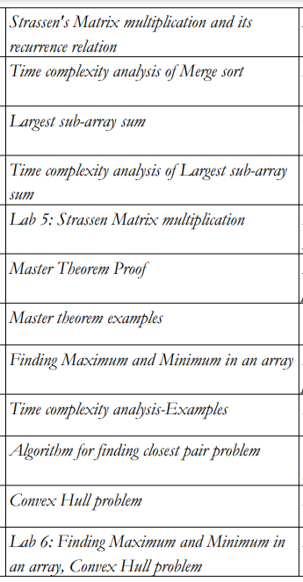

Slide 5
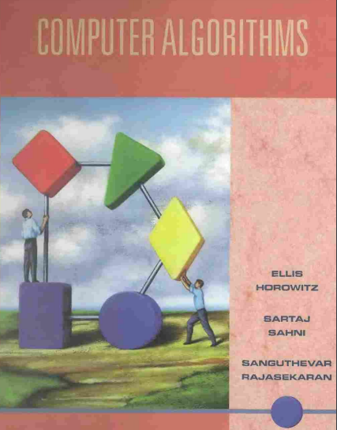
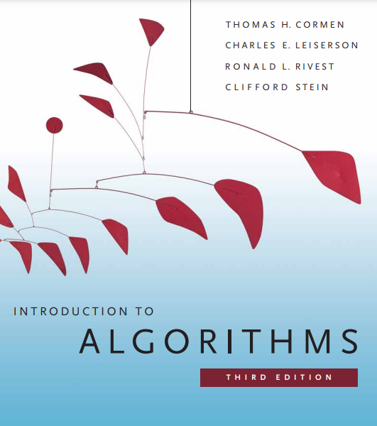

Slide 6
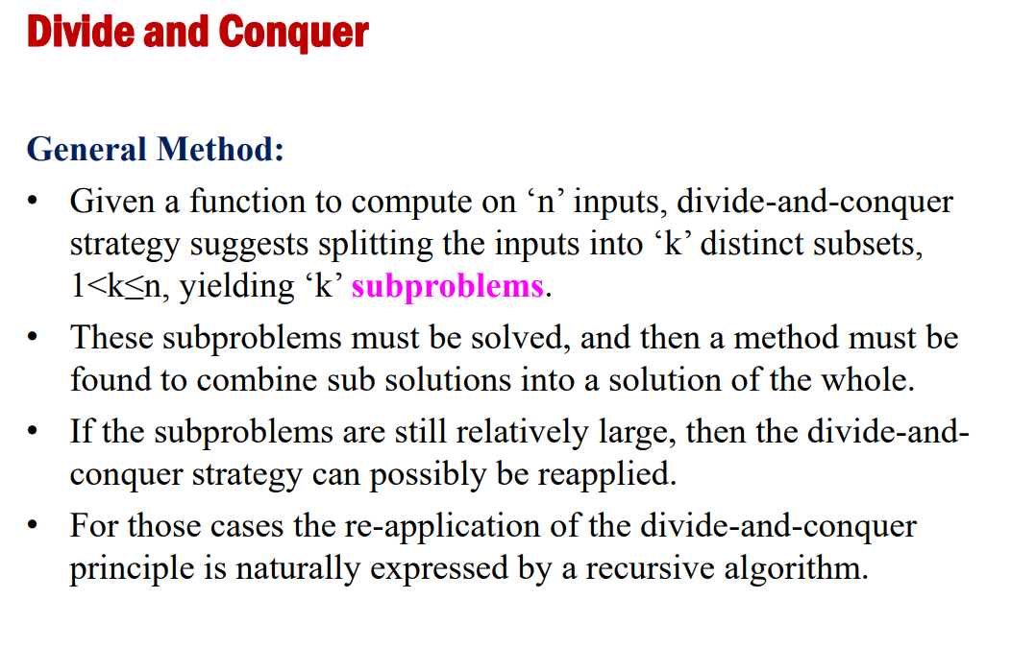

Slide 7

In divide and conquer method, the problem is divided into smaller sub-problems and then each problem is solved independently.
When the subproblems is divided into even smaller sub-problems, it should reach a stage where no more division is possible.
Those "atomic" smallest possible sub-problem (fractions) are solved.
The solution of all sub-problems is finally merged in order to obtain the solution of an original problem.

Slide 8
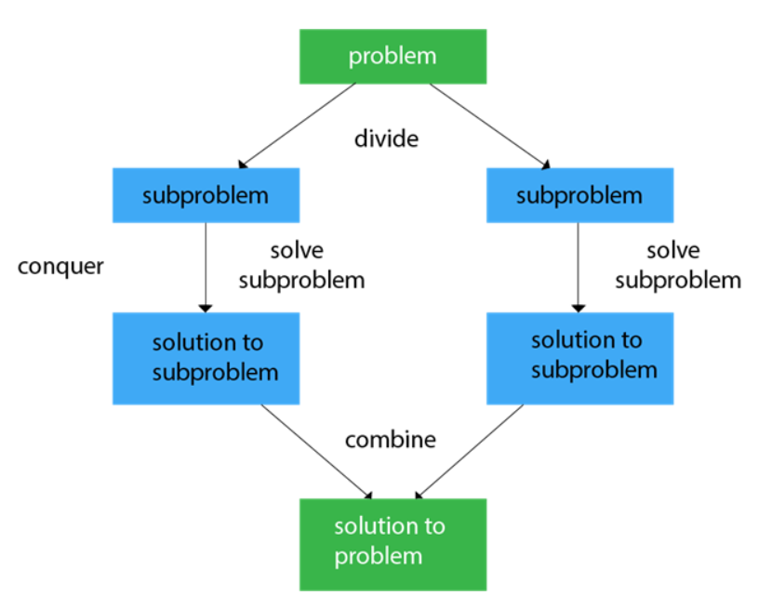

Slide 9
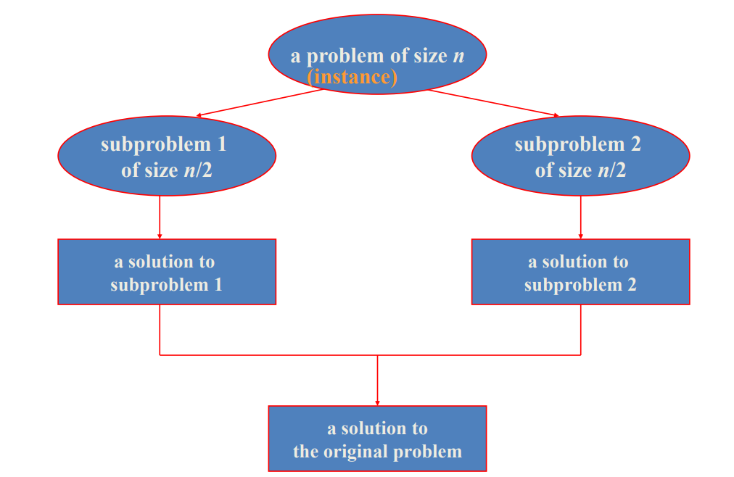
SAME AS PROBLEM

Slide 10
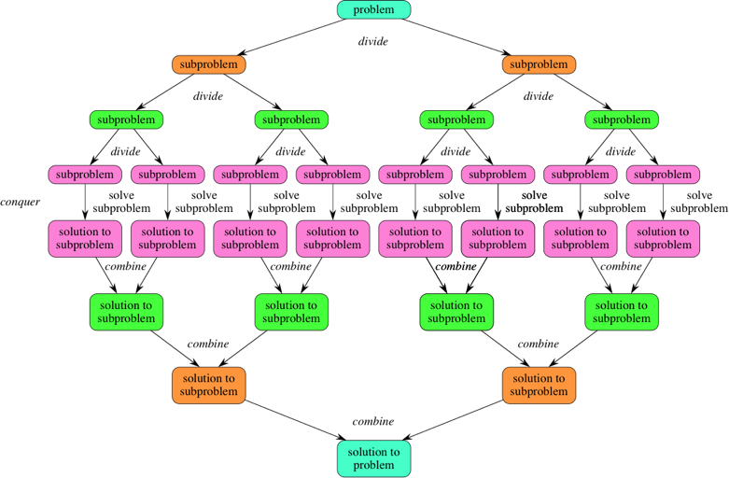

Slide 11
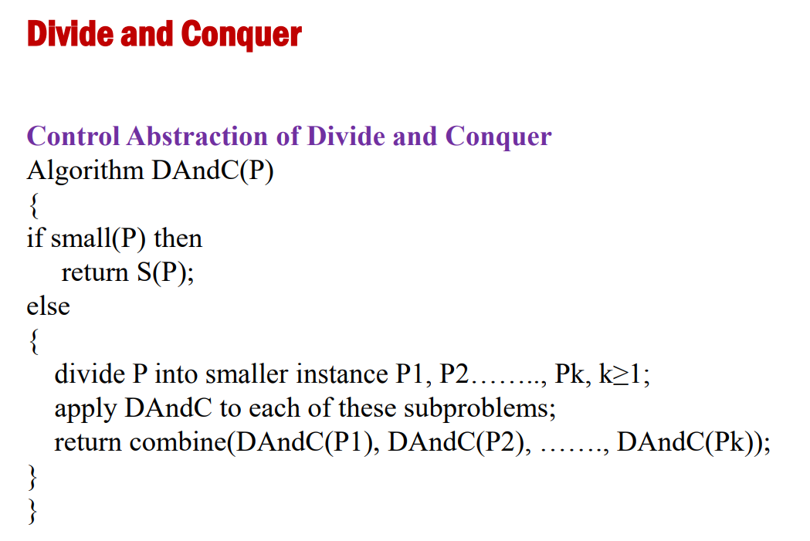

Slide 12
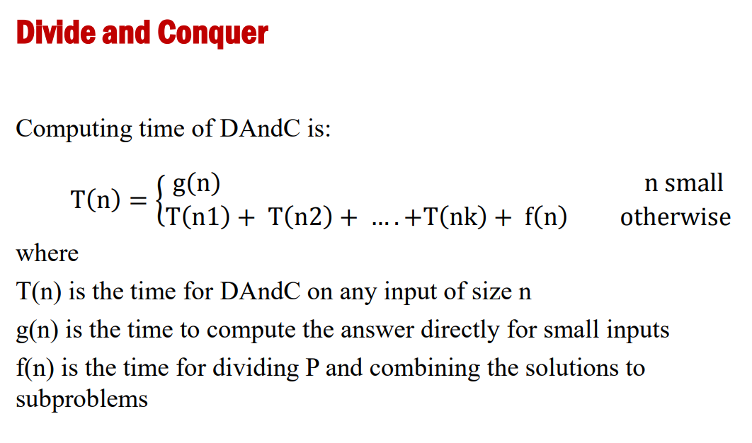

Slide 13
Introduction
In divide and conquer method, the problem is divided into smaller sub-problems and then each problem is solved independently.
When the subproblems is divided into even smaller sub-problems, it should reach a stage where no more division is possible.
Those "atomic" smallest possible sub-problem (fractions) are solved.
The solution of all sub-problems is finally merged in order to obtain the solution of an original problem.

Slide 14
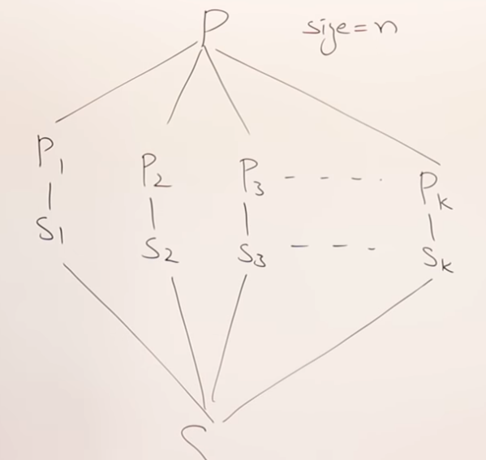
Divide and Conquer
If a problem cannot be solved if it is big then solve it by breaking into subproblems.
If the subproblem is also not able solve again break into sub problems.
Repeat step 2 until the subproblem can be solved.

Slide 15
Divide and Conquer
In divide-and-conquer, we solve a problem recursively, applying three steps at each level of the recursion:
Divide the problem into a number of subproblems that are smaller instances of the same problem.
Conquer the subproblems by solving them recursively. If the subproblem sizes are small enough, however, just solve the subproblems in a straightforward manner.
Combine the solutions to the subproblems into the solution for the original problem.

Slide 16
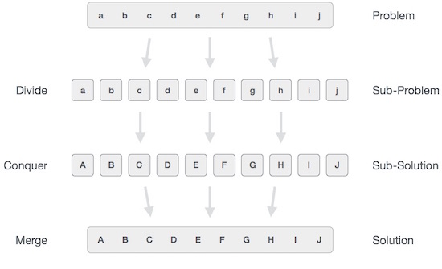
Divide-and-conquer method in a three-step process:

Slide 17
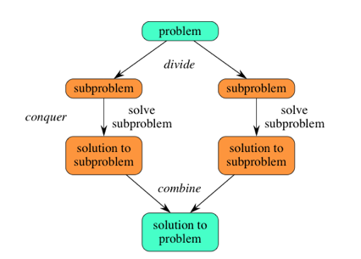

Slide 18
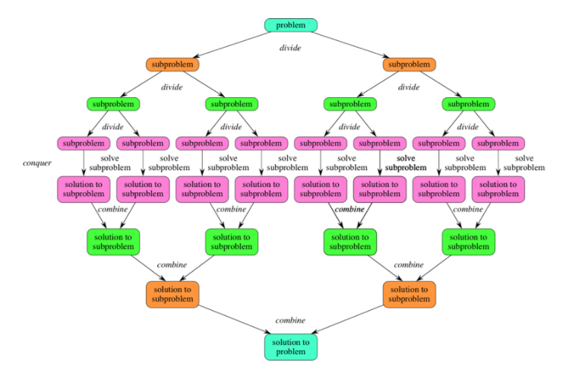

Slide 19
Control Abstraction of Divide and Conquer
DAC(Problem P)
{
if(small(P)
{
Solve(P);
}
else
{
Divide P into P1, P2, P3,..Pk;
apply DAC(P1), DAC(P2)…DAC(Pk);
combine(DAC(P1),DAC(P2)….DAC(Pk));
}
}

Slide 20
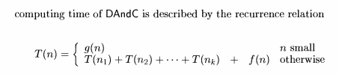
General relation expressing Time Complexity of DaC Algorithms
T(n) is the time for DAndC on any input of size n and
g(n) is the time to compute the answer directly for small inputs.
The function f(n) is the time for dividing P and combining the solutions to sub problems.
For divide and-conquer-based algorithms that produce sub problems of the same type as the original problem, it is very natural to first describe such algorithms using recursion.

Slide 21
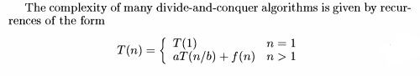
General relation expressing Time Complexity of DaC Algorithms

Slide 22
Applications
Maximum subarray Problem
Binary Search
Merge Sort
Quick Sort
Strassen's Matrix multiplication
Largest sub-array sum
Finding closest pair problem
Convex Hull problem

Slide 23
The following are some standard algorithms that follows Divide and Conquer algorithm.
1.Binary Search is a searching algorithm. In each step, the algorithm compares the input element x with the value of the middle element in array. If the values match, return the index of the middle. Otherwise, if x is less than the middle element, then the algorithm recurs for left side of the middle element, else recurs for the right side of the middle element.
2.Quicksort is a sorting algorithm. The algorithm picks a pivot element, rearranges the array elements in such a way that all elements smaller than the picked pivot element move to left side of pivot, and all greater elements move to right side. Finally, the algorithm recursively sorts the subarrays on left and right of pivot element.

Slide 24
3.Merge Sort is also a sorting algorithm. The algorithm divides the array in two halves, recursively sorts them and finally merges the two sorted halves.
4.Closest Pair of Points The problem is to find the closest pair of points in a set of points in x-y plane. The problem can be solved in O(n^2) time by calculating distances of every pair of points and comparing the distances to find the minimum. The Divide and Conquer algorithm solves the problem in O(nLogn) time.
5.Strassen’s Algorithm is an algorithm to multiply two matrices. A simple method to multiply two matrices need 3 nested loops and is O(n^3).

Slide 25
Maximum sub array Problem
Problem: given an array of n numbers, find the (a) contiguous sub array whose sum has the largest value.
Maximum sub array is 2+4+1+5+8= 20
Sub array1,(-2+4-1=1)
Sub array2, (4-1-5=-2)
Sub array 3, (-1-5+8=2)
Max(1,-2,2) is 2 sub array is (-1,-5,8)
2 | 4 | 1 | 5 | 8
-2 | 4 | -1 | -5 | 8

Slide 26
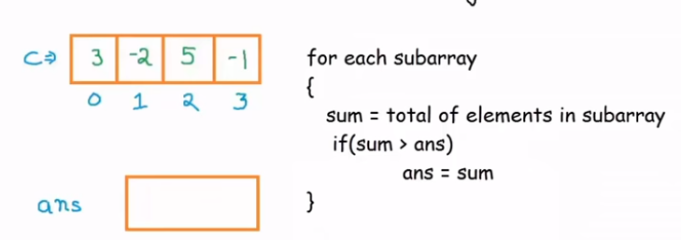
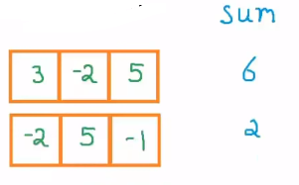
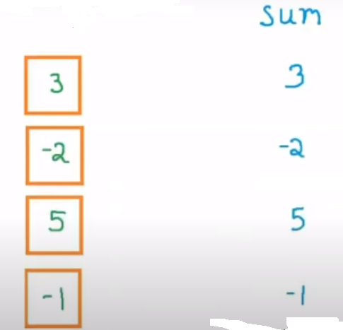
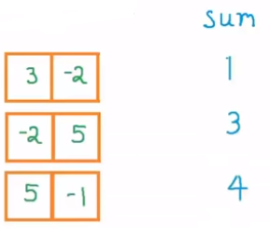
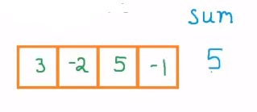
A brute-force solution

Slide 27
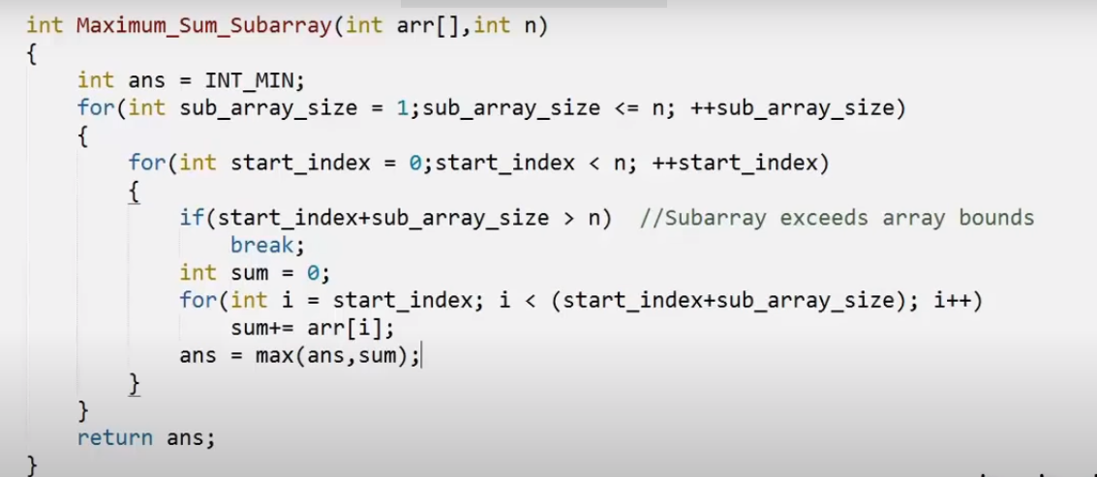
Brute Force algorithm
O(n³)

Slide 28
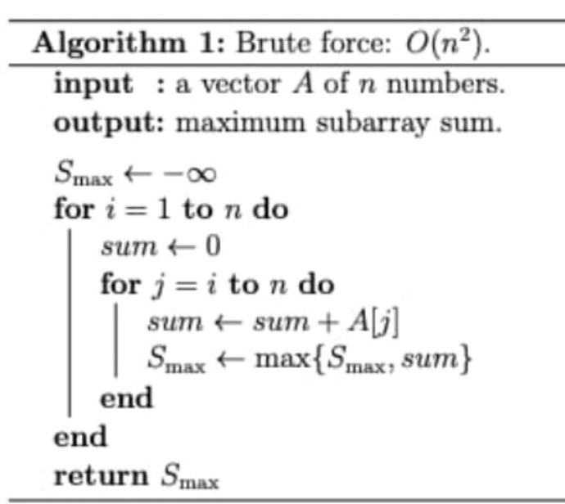
O(n²)

Slide 29
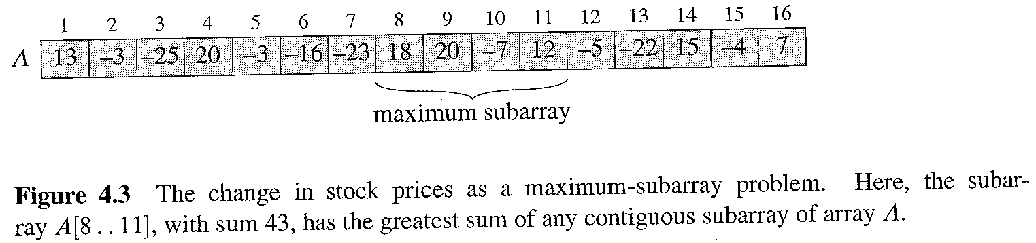
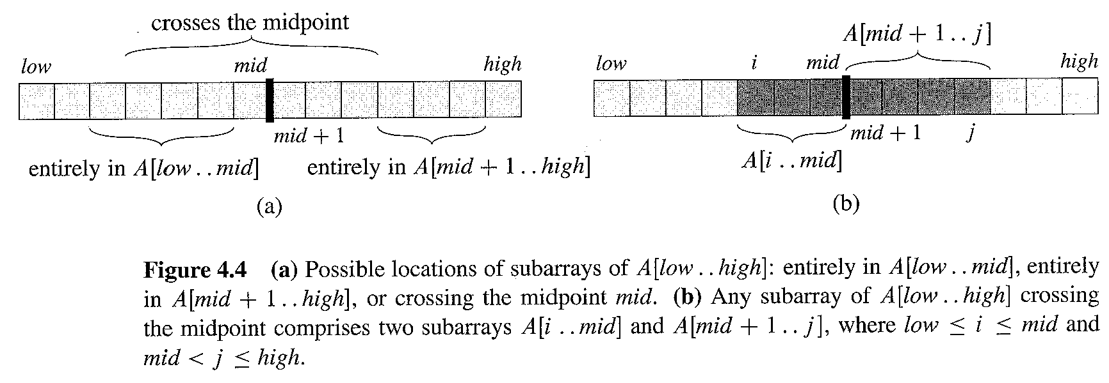
Max Subarray

Slide 30
Max Subarray
How do we divide?
We observe that a maximum contiguous subarray A[i…j] must be located as follows:
It lies entirely in the left half of the original array: [low…mid];
It lies entirely in the right half of the original array: [mid+1…high];
It straddles the midpoint of the original array: i ≤ mid < j.

Slide 31
Max Subarray: Divide & Conquer
The “left” and “right” subproblems are smaller versions of the original problem, so they are part of the standard Divide & Conquer recursion.
The “middle” subproblem is not, so we will need to count its cost as part of the “combine” (or “divide”) cost.
The crucial observation (and it may not be entirely obvious) is that we can find the maximum crossing subarray in time linear in the length of the A[low…high] subarray.
How? A[i,…,j] must be made up of A[i…mid] and A[m+1…j] – so we find the largest A[i…mid] and the largest A[m+1…j] and combine them.

Slide 32
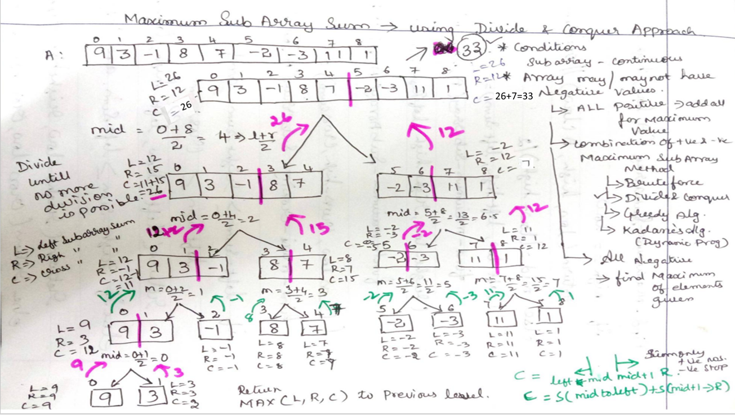

Slide 33
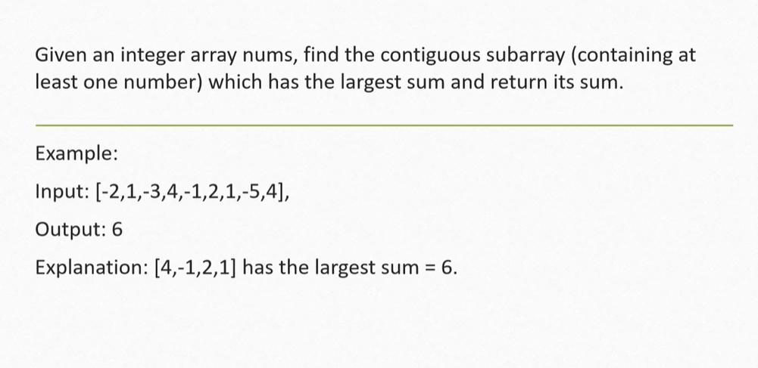
Max Subarray

Slide 34
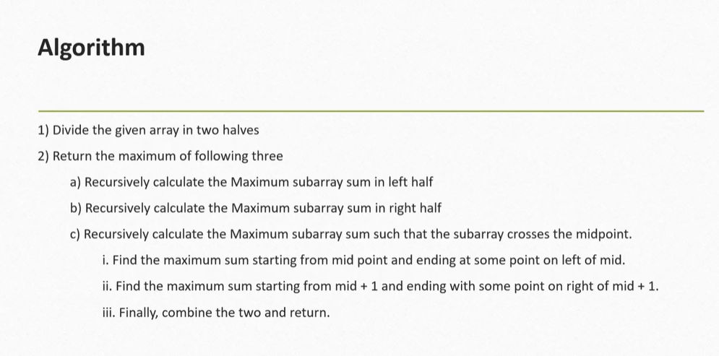

Slide 35
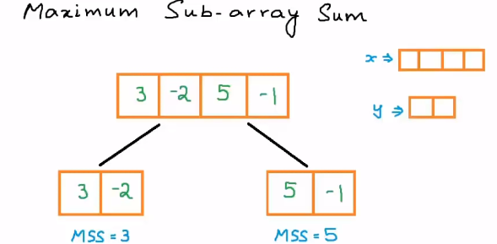
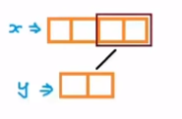
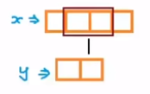
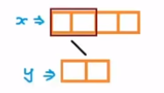
Example

Slide 36
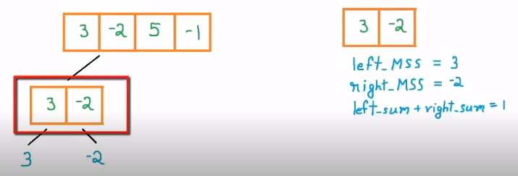
Example

Slide 37
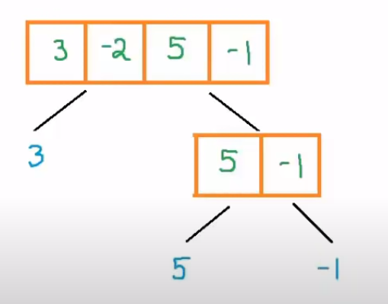
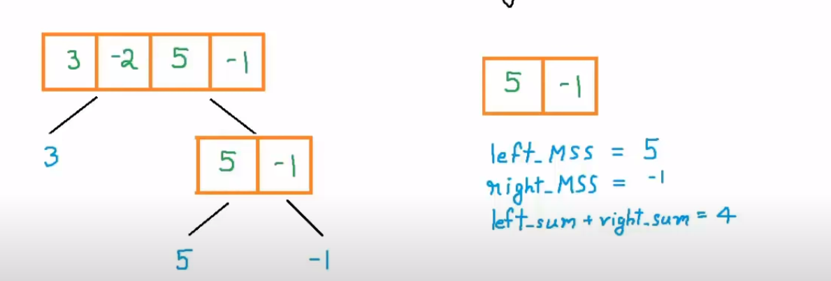
Example

Slide 38
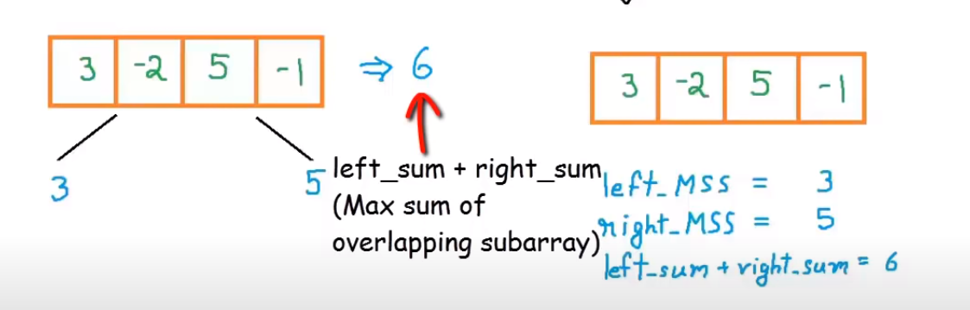
Example

Slide 39
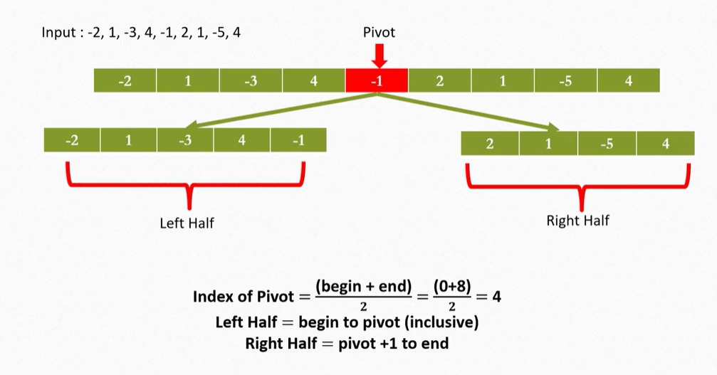
Example

Slide 40
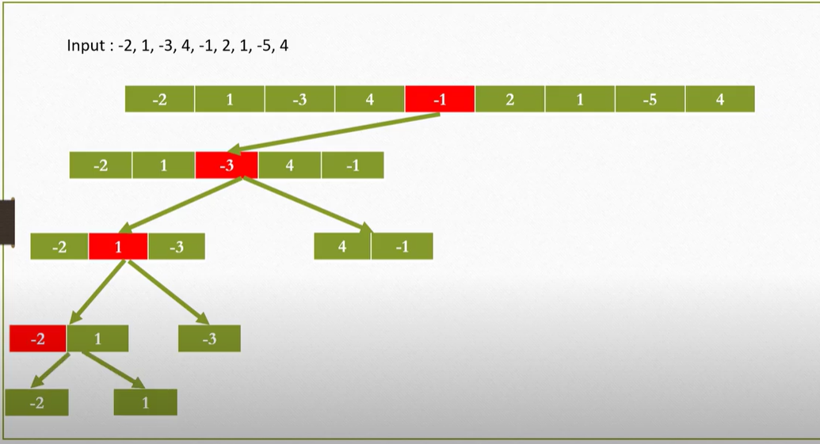
Example

Slide 41
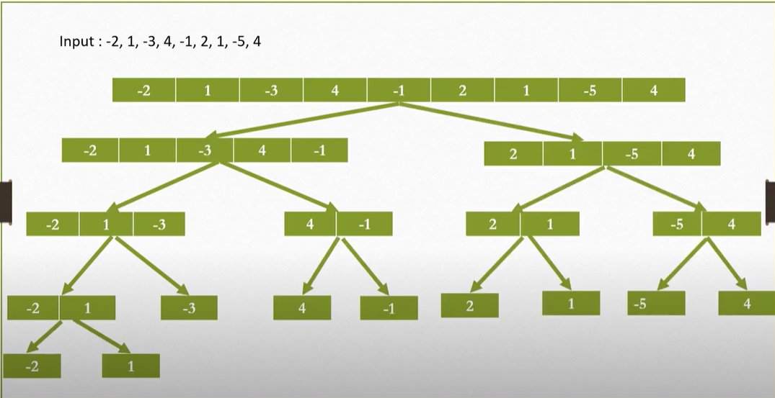
Example

Slide 42
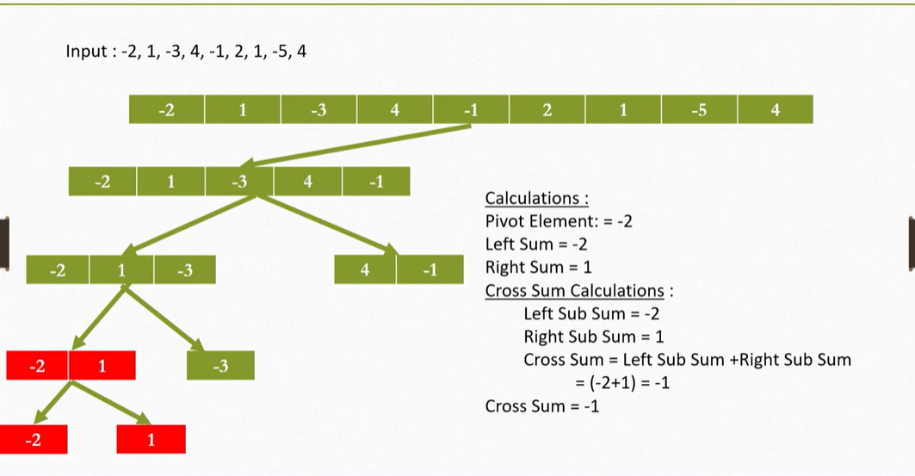
Example

Slide 43
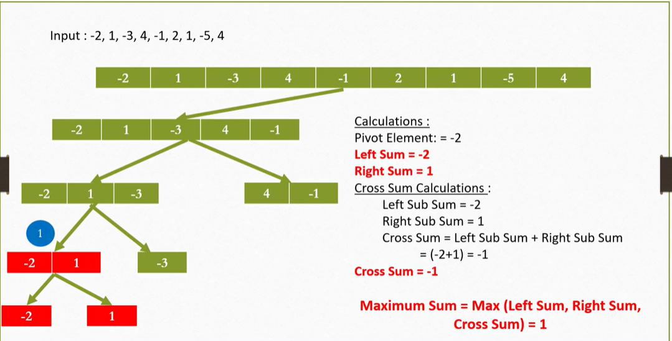
Example

Slide 44
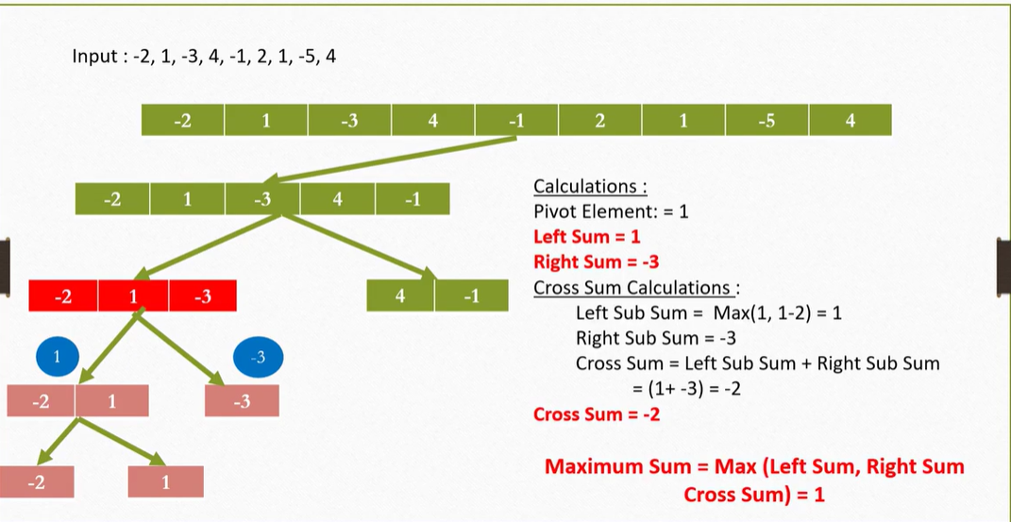
Example

Slide 45
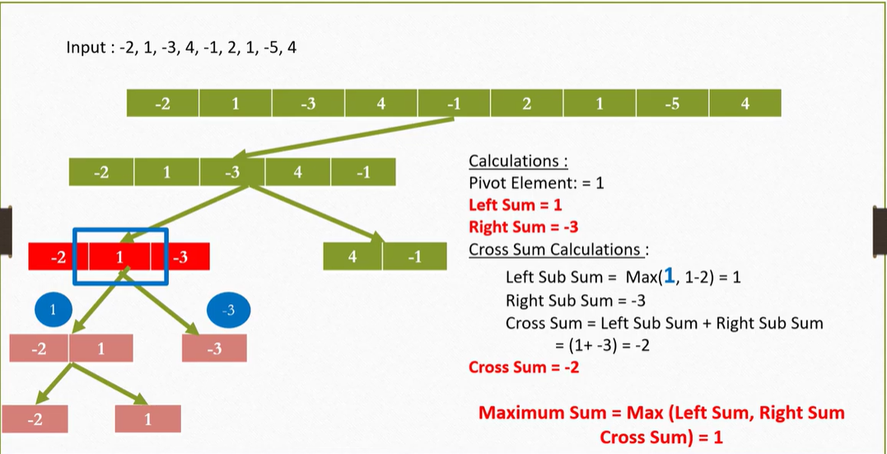
Example

Slide 46
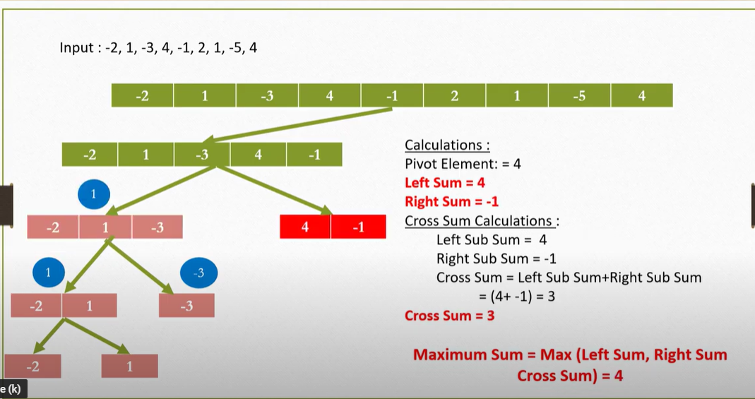
Example

Slide 47
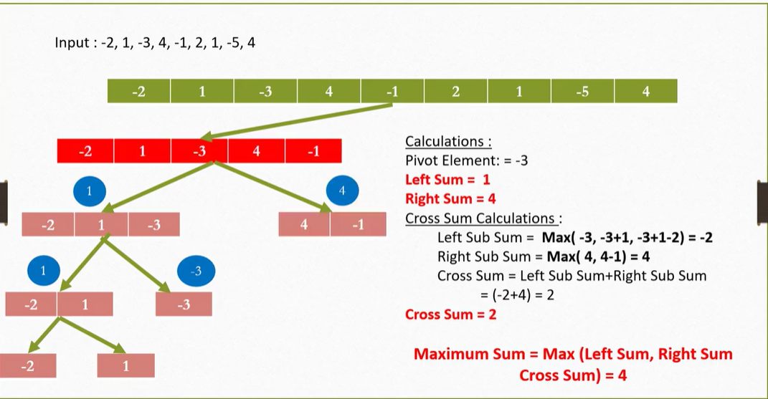
Example

Slide 48
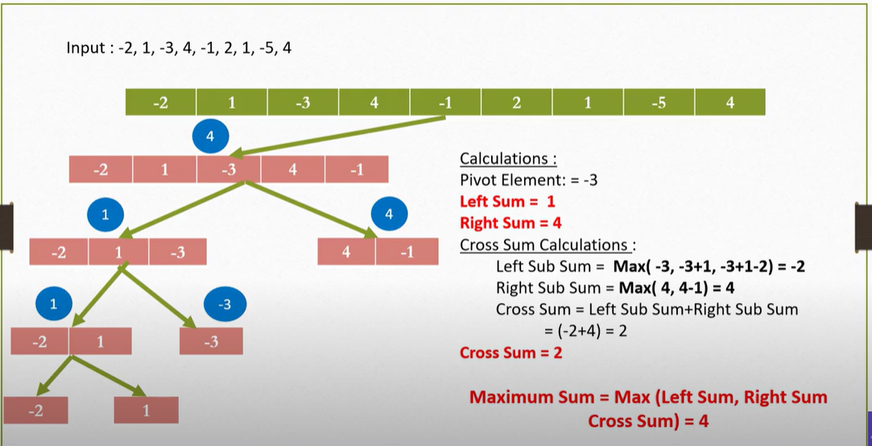
Example

Slide 49
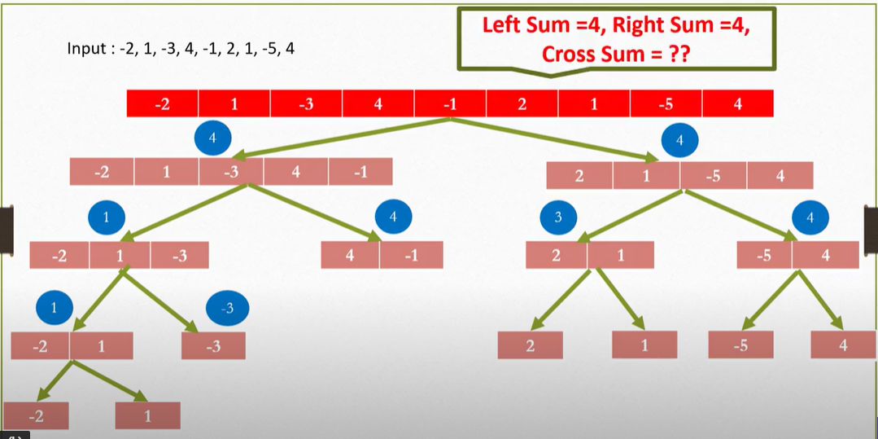
Example

Slide 50
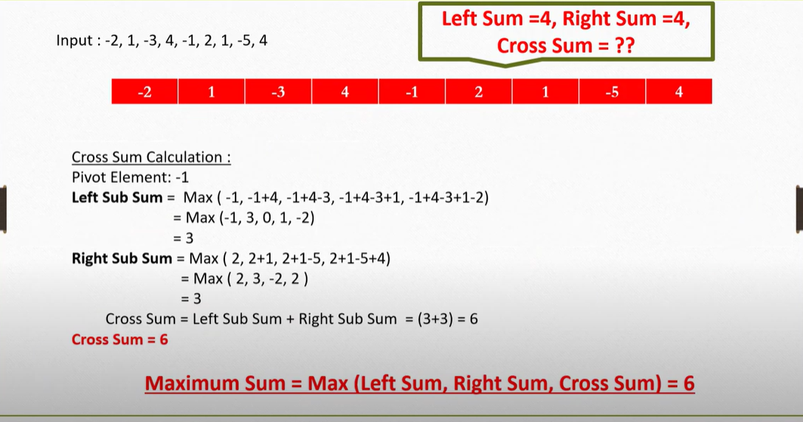
Example

Slide 51
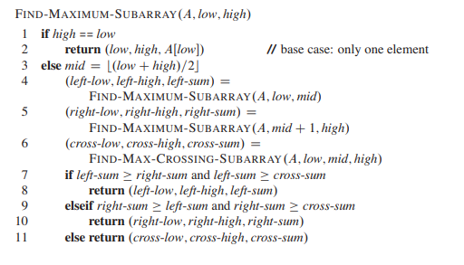
Algorithm: Maximum Sub array

Slide 52
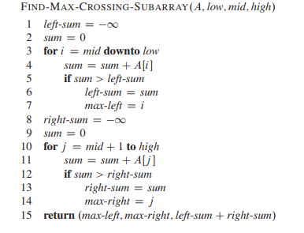
Algorithm: Maximum Crossing Sub Array

Slide 53

Time Complexity Analysis

Slide 54


Slide 55

Maximum Sub-array Sum - Greedy Algorithm -example

Slide 56


Slide 57

KADANES’S ALGORITHMN – DYNAMIC PROGRAMMING – MAXIMUM SUB ARRAY SUM

Slide 58
Application
Application: an unrealistic stock market game, in which you decide when to buy and see a stock, with full knowledge of the past and future. The restriction is that you can perform just one buy followed by a sell. The buy and sell both occur right after the close of the market.
The interpretation of the numbers: each number represents the stock value at closing on any particular day.

Slide 59

Maximum Subarray Problem
Example:

Slide 60

Maximum Subarray Problem
Another Example: buying low and selling high, even with perfect knowledge, is not trivial:

Slide 61
A Better Solution: Max Subarray
Transformation: Instead of the daily price, let us consider the daily change: A[i] is the difference between the closing value on day i and that on day i-1.
The problem becomes that of finding a contiguous subarray the sum of whose values is maximum.

Slide 62
Home Assignment
Find the sub array sum of the following array,
-2, -5, 6, -2, -3, 1, 5, -6
1,-3,2, -5, 7, 6, -1, -4, 11, -23

Slide 63

BINARY SEARCH

Slide 64
Binary Search Session Learning Outcome-SLO-Solve problems using divide and conquer approaches
Motivation of the topic Binary Search is one of the fastest searching algorithms.
It is used for finding the location of an element in a linear array.
It works on the principle of divide and conquer technique.
Binary Search Algorithm can be applied only on Sorted arrays.
So, the elements must be arranged in-
Either ascending order if the elements are numbers.
Or dictionary order if the elements are strings.
To apply binary search on an unsorted array,
First, sort the array using some sorting technique.
Then, use binary search algorithm.

Slide 65
Binary search is an efficient searching method. While searching the elements using this method the most essential thing is that the elements in the array should be a sorted one.
An element which is to be searched from the list of elements stored in the array A[0---n- 1] is called as Key element.
Let A[m] be the mid element of array A. Then there are three conditions that need to be tested while searching the array using this method.
They are given as follows
If key==A[m] then desired element is present in the list.
Otherwise if key <=A[m] then search the left sub list
Otherwise if Key>=A[m] then search the right sub list The following algorithm explains about binary search.

Slide 66
Algorithm
Input: A array A[0...n-1] sorted in ascending orderand search key K.
Output: An index of array element which is equal to k
L🡨0;h 🡨n-1
Algorithm RBinSearch(l, h,key)
{
If(l==h) // for small problem(ie when n=1)
{
if(A[i]==key)
return l;
else
return 0;
}
else
{
mid=(l+h)/2;
If(key==A{mid})
return mid;
If(key<a[mid])r
return RBinSearch(l,mid-1,key);
else
return RBinSearch ( mid+1,h,key);
}

Slide 67

Time Complexity Analysis

Slide 68

Time Complexity Analysis

Slide 69
Time Complexity Analysis
1 n=1
T(n)=
T(n/2) n>1
Time complexity is O(log₂n)

Slide 70
ANALYSIS
The basic operation in binary search is comparison of search key with array elements.
To analyze efficiency of binary search we must count the number of times the search gets compared with the array elements.
The comparison is also called three way comparisons because the algorithm makes the comparison to determine whether key is smaller, equal to or greater than A[m].
In this algorithm after one comparison the list of n elements is divided into n/2 sub list.
The worst case efficiency is that the algorithm compares all the array elements for searching the desired element.
In this method one comparison is made and based on the comparison array is divided each time in n/2 sub list.

Slide 71

Best Case Analysis of Binary Search

Slide 72

Best Case Analysis of Binary Search

Slide 73

Worst Case Analysis of Binary Search

Slide 74

Worst Case Analysis of Binary Search

Slide 75

Worst Case Analysis of Binary Search

Slide 76

Worst Case Analysis of Binary Search

Slide 77

Worst Case Analysis of Binary Search

Slide 78

Worst Case Analysis of Binary Search

Slide 79

Worst Case Analysis of Binary Search

Slide 80
EXAMPLE FOR BINARY SEARCH
Step:1 Consider a list of elements sorted in array A as
0 1 2 3 4 5 6
Low high
The Search key element is key=60
Now to obtain middle element we will apply formula
mid=(low+high)/2
mid=(0+6)/2
mid=3
Then check A[mid]==key, A[3]=40
A[3]!=60 Hence condition failed
Then check key>A[mid],A[3]=40
60>A[3] Hence condition satisfied so search the Right Sublist
10 | 20 | 30 | 40 | 50 | 60 | 70

Slide 81

Step 2:
The Right Sublist is
Now we will again divide this list to check the mid element
4 5 6
Left sublist mid right sublist
mid=(low+high)/2
mid=(4+6)/2
mid=5
Check if A[mid]==key
(i.e)A[5]==60.Hence condition is satisfied. The key element is present in position 5.
The number is present in the Array A[ ] at index position 5.
50 | 60 | 70

Slide 82

We can analyze the best case , Worst case and Average case . The time complexity of binary search is given as follows
In conclusion we are now able to completely describe the computing time of binary search by giving formulas that describe best, average and worst cases
Successful searches unsuccessful searches
best average worst best, average, worst

Slide 83
Advantages of Binary search:
Binary search is an optimal searching algorithm using which we can search the desired element very efficiently
Disadvantages of binary Search :
This Algorithm requires the list to be sorted . Then only this method is applicable
Applications of binary search:
The binary search is an efficient searching method and is used to search desired record from database
For solving with one un known this method is used

Slide 84

Summary:
Binary Search time complexity analysis is done below-
In each iteration or in each recursive call, the search gets reduced to half of the array.
So for n elements in the array, there are log₂n iterations or recursive calls.
Time Complexity of Binary Search Algorithm is O(log₂n).
Here, n is the number of elements in the sorted linear array.
Home assignment:
Search the Element 15 from the given array using Binary Search Algorithm.

Slide 85
Merge Sort
The merge sort algorithm closely follows the divide-and-conquer paradigm. Intuitively, it operates as follows.
Divide: Divide the n-element sequence to be sorted into two subsequences of n=2 elements each.
Conquer: Sort the two subsequences recursively using merge sort.
Combine: Merge the two sorted subsequences to produce the sorted answer.

Slide 86

Merge Sort Procedure
Step1: Divide an array A into subarrays B and C
Step 2: Sort subarray B recursively; this yields B sorted subarray
Step 3: Sort subarray C recursively; this yields C sorted subarray
Step 4: Combine B and C sorted subarrays to obtain the final sorted array A

Slide 87

Merge Procedure

Slide 88

Merge Procedure

Slide 89


Slide 90


Algorithm: Merge-Sort

Slide 91
Recurrence Relation of Merge Sort
1 n=1
T(n)=
2T(n/2)+D(n)+C(n) n>1
It takes time T (n/b) to solve one subproblem of size n/b, and so it takes time aT (n/b) to solve a of them.
D(n) time to divide the problem into subproblems and
C(n) time to combine the solutions to the subproblems into the solution to the original problem.

Slide 92


Recurrence Relation of Merge Sort

Slide 93
Analysis of Merge Sort
Worst Case Time Complexity [ Big-O ]: O(n*log n)
Best Case Time Complexity [Big-omega]: O(n*log n)
Average Time Complexity [Big-theta]: O(n*log n)

Slide 94
Home Assignment
A = {3, 41, 52, 26, 38, 57, 9, 49}
B= { 38, 27, 43, 3, 9, 82,10}
C= { 70, 20,30,40, 10, 50, 60}

Slide 95
Quick Sort

Slide 96
Introduction
An efficient sorting algorithm
Based on partitioning of array of data into smaller arrays
Developed by British computer scientist Tony Hoare in 1959 and published in 1961
Two or three times faster than other sorting algorithms
Uses divide and conquer strategy
Quicksort is a comparison sort
Sometimes called partition-exchange sort

Slide 97
Three operations performed in quick sort
Divide: Select a 'pivot' element from the array and partition the other elements into two sub-arrays, according to whether they are less than or greater than the pivot.
Conquer : Recursively sort the two sub arrays
Combine : Combine all the sorted elements in a group to form a list of sorted elements.

Slide 98
How Quick sort works
Select a PIVOT element from the array
You can choose any element from the array as the pivot element.
Here, we have taken the first element of the array as the pivot element.
The elements smaller than the pivot element are put on the left and the elements greater than the pivot element are put on the right.
Now sort the left and right arrays recursively.
34 | 42 | 16 | 71 | 9 | 22 | 53 | 13
9 | 18 | 16 | 22 | 34 | 71 | 42 | 53

Slide 99
Algorithm Quicksort
Quicksort(A, L,H)
{
// Array to be soerrted
// L – lower bound of array
// H- upper bound of array
If (L<H)
{
P=Partition(A,L,H)
Quicksort(A,L,P)
Quicksort(A,P+1,H)
}
}

Slide 100
Algorithm Partition
Partition(A,L,H)
{
pivot = A[L]
i=L, j=H+1
repeat
repeat i=i+1 until A[i]>=pivot
repeat j=j-1 until A[j]<=pivot
swap(a[i],a[j])
until (i>j)
swap(A[L],A[j])
}

Slide 101

Method with Example (Partition)

Slide 102
Recurrence Relation of Quick Sort
1 n=1
T(n)=
2T(n/2)+cn n>1

Slide 103
Analysis of Quick Sort Algorithm
If pivot element is either the largest or the smallest element
Then one partition will have 0 elements and the other partition will have (n-1) elements.
Eg : if pivot element is the largest element in the array. We will have all the elements except the pivot element in the left partition and no elements in the right partition
The recursive calls will be on arrays of size 0 and (n-1)

Slide 104




Best Case Analysis

Slide 105

Quick Sort : Best-case running time
Quick Sort - Best-case running time
Occurs when the partitions are evenly partitioned.
quicksort's Best-case running time is

Slide 106

Worst Case Analysis
When the array is sorted and pivot is either first element or last element.

Slide 107






Quick Sort - Worst-case running time

Slide 108

Quick Sort - Worst-case running time
Let the original call takes cn time for some constant c.
Recursive call on n-1 elements takes c(n-1)times
Recursive call on n-2 elements takes time c(n-2) times, and so on.
Recursive call on 2 elements will take 2c times
Finally recursive call on 1 element will take no time.

Slide 109
Worst-case running time
Sum up the partitioning times, we get
cn + c(n-1) + c(n-2) + ….+ 2c
= c(n + (n-1) + (n-2) + …. + 2)
= c((n+1)(n/2) - 1)
[Note : 1+2+…+(n-1)+n=(n+1)n/2
So 2+…+(n-1)+n=((n+1)n/2)-1]
quicksort's worst-case running time is

Slide 110

Quick Sort : Average-case running time
Quick Sort – Average -case running time
imagine that we don't always get evenly balanced partitions
but that we always get at worst a 3-to-1 split
That is, imagine that each time we partition, one side gets 3n/4 elements and the other side gets n/4 elements
quicksort's Average-case running time is

Slide 111
Quick Sort
Advantages of Quick Sort-
The advantages of quick sort algorithm are-
Quick Sort is an in-place sort, so it requires no temporary memory.
Quick Sort is typically faster than other algorithms.
(because its inner loop can be efficiently implemented on most architectures)
Quick Sort tends to make excellent usage of the memory hierarchy like virtual memory or caches.
Quick Sort can be easily parallelized due to its divide and conquer nature.
Disadvantages of Quick Sort-
The disadvantages of quick sort algorithm are-
The worst case complexity of quick sort is O(n²).
This complexity is worse than O(nlogn) worst case complexity of algorithms like merge sort, heap sort etc.
It is not a stable sort i.e. the order of equal elements may not be preserved.

Slide 112
Comparison
Algorithm | Time Complexity
 | Best | Average | Worst
Selection Sort | Ω(n^2) | θ(n^2) | O(n^2)
Bubble Sort | Ω(n) | θ(n^2) | O(n^2)
Insertion Sort | Ω(n) | θ(n^2) | O(n^2)
Heap Sort | Ω(n log(n)) | θ(n log(n)) | O(n log(n))
Quick Sort | Ω(n log(n)) | θ(n log(n)) | O(n^2)
Merge Sort | Ω(n log(n)) | θ(n log(n)) | O(n log(n))

Slide 113
Home assignment
Sort the following numbers using Quick sort
21, 45, 32, 76, 12, 83, 47, 153, 52
75, 34, 64, 82,35,79,12,53,40,61

